Slide 1
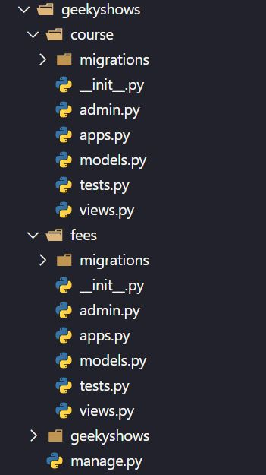
Multiple Applications inside Project
Syntax:- python manage.py startapp appname
Creating One Application inside Project Steps:-
Go to Project Folder (cd geekyshows)
Run Command python manage.py startapp course
Creating Multiple Applications inside Project Steps:-
Go to Project Folder (cd geekyshows)
python manage.py startapp course
python manage.py startapp fees

Slide 2
How to Install Application in Our Project
As we know a project can contain multiple application so just creating application inside a project is not enough we also have to install application in our project.
We install application in our project using setting.py file.
setting.py file is available at Project Level which means we can install all the application of project.
This is compulsory otherwise Application won’t be recognized by Django.
Open setting.py file
INSTALLED_APPS = [
‘django.contrib.admin’,
‘application_name1’,
‘application_name2’,
]
Save settings.py File
INSTALLED_APPS = [
‘django.contrib.admin’,
‘course’,
]
INSTALLED_APPS = [
‘django.contrib.admin’,
‘course’,
‘fees’,
]

Slide 3
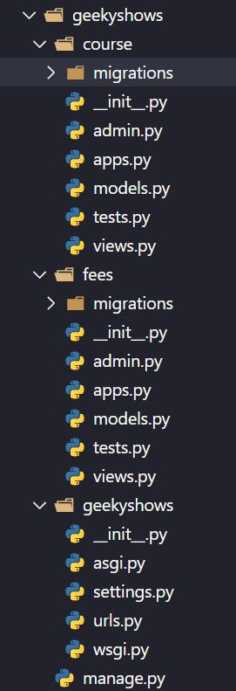
Function Based Views
views.py of course
from django.http import HttpResponse
def learn_django(request):
return HttpResponse(‘Hello Django’)
views.py of fees
from django.http import HttpResponse
def fees_django(request):
return HttpResponse(‘300’)

Slide 4
URL Pattern
views.py of course
from django.http import HttpResponse
def learn_django(request):
return HttpResponse(‘Hello Django’)
views.py of fees
from django.http import HttpResponse
def fees_django(request):
return HttpResponse(‘300’)
urls.py
from course import views
from fees import views
urlpatterns = [
path(‘learndj/’, views.learn_django),
path(‘feesdj/’, views.fees_django),
]

Slide 5
URL Pattern
views.py of course
from django.http import HttpResponse
def learn_django(request):
return HttpResponse(‘Hello Django’)
views.py of fees
from django.http import HttpResponse
def fees_django(request):
return HttpResponse(‘300’)
urls.py
from course import views as cv
from fees import views as fv
urlpatterns = [
path(‘learndj/’, cv.learn_django),
path(‘feesdj/’, fv.fees_django),
]
urls.py
from course.views import learn_django
from fees.views import fees_django
urlpatterns = [
path(‘learndj/’, learn_django),
path(‘feesdj/’, fees_django),
]

Slide 6
Geeky Steps
Create Django Project: django-admin startproject geekyshows
Change Directory to Django Project: cd geekyshows
Create Django Application1: python manage.py startapp course
Create Django Application2: python manage.py startapp fees
Add/Install Applications to Django Project (course and fees to geekyshows) using settings.py INSTALLED_APPS
Write View Function inside views.py file
Define url for view function of application using urls.py file

